Slide 1


poseControl Drone Control via Pose
Group 5
Ben Saunders, Ujwal Sanne
Yik Lung Pang, Jintao Yang, Qi Guo

Slide 2
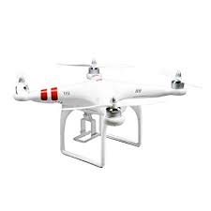
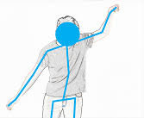
poseControl App
Autonomous drone control via gesture cues.
Hands-free control through video feed
Multiple gestures detected with corresponding actions implemented

Slide 3
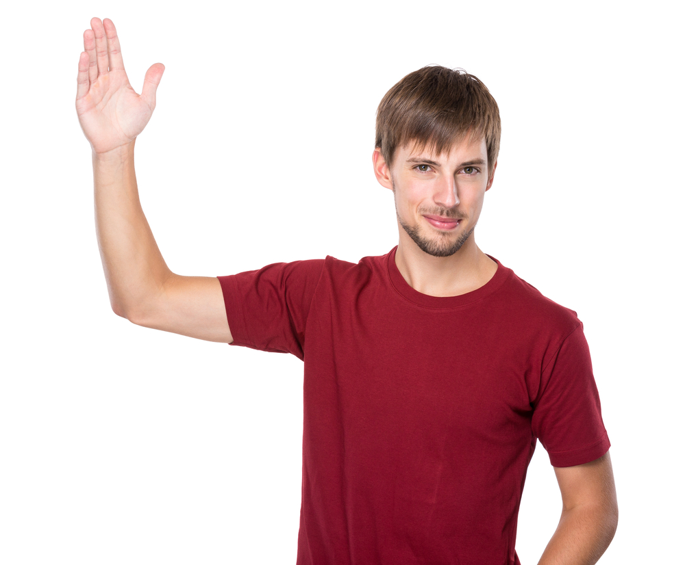
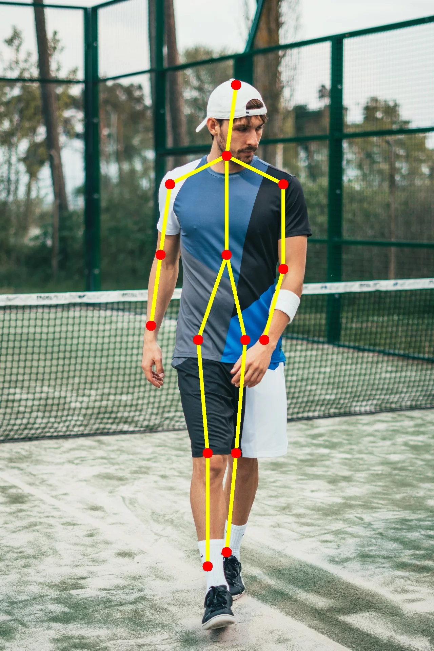
Current State (Beta)
openPose body detection implemented via Caffe
Single-Person Gesture recognition
Right Hand: Go Right
Left Hand: Go Left
Both Hands: Stop

Slide 4
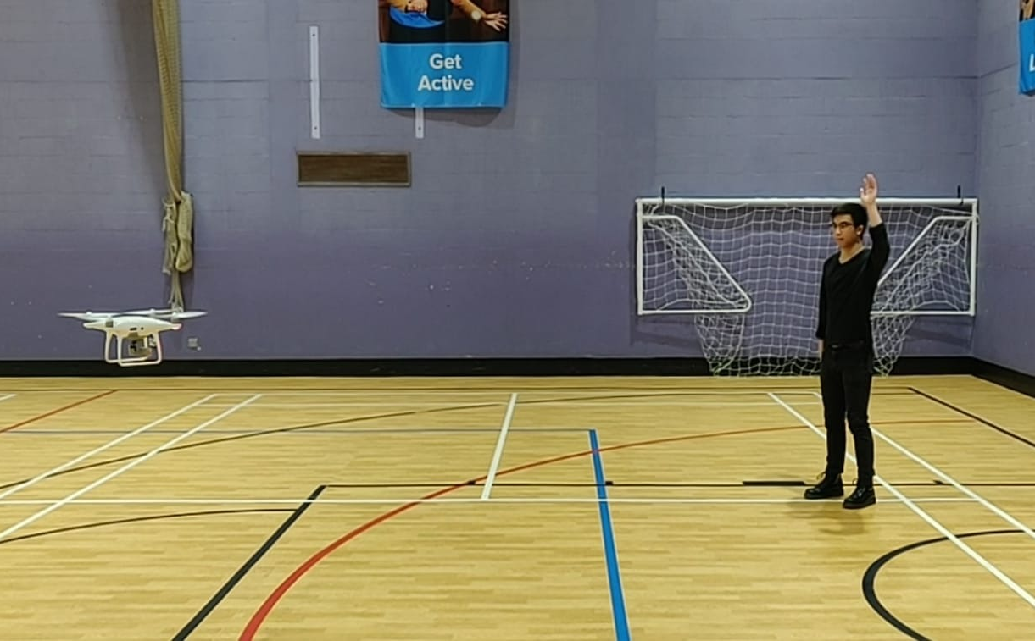
Showcase

Slide 5
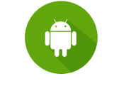

Challenges
Pose Estimation in real-time
Connection of drone SDK to Computer Vision Libraries
Gesture to action detection

Slide 6
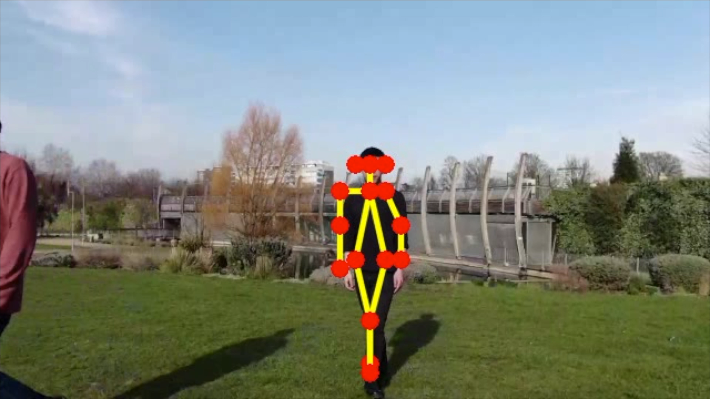
Demo

Slide 7
Future Features
More actions:
Closed fist - Stop the drone
Waved - Come track you
Hand on the ground - Land where you are
Point at an object - Track that object/attack
Registering new unique gestures and corresponding actions
Multi-Person pose detection

Slide 8
Thanks for listening!
Group 5
Ben Saunders, Ujwal Sanne
Yik Lung Pang, Jintao Yang, Qi Guo

